Slide 1
Hidden Markov Models
1
1
1
1
…
1
2
2
2
2
2
…
2
…
…
…
…
K
K
K
K
…
K
x₁
x₂
x₃
x_{K}

Slide 2
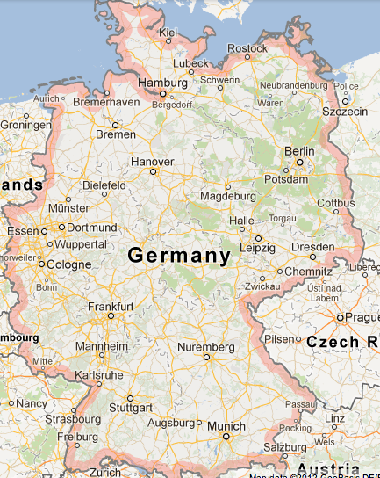
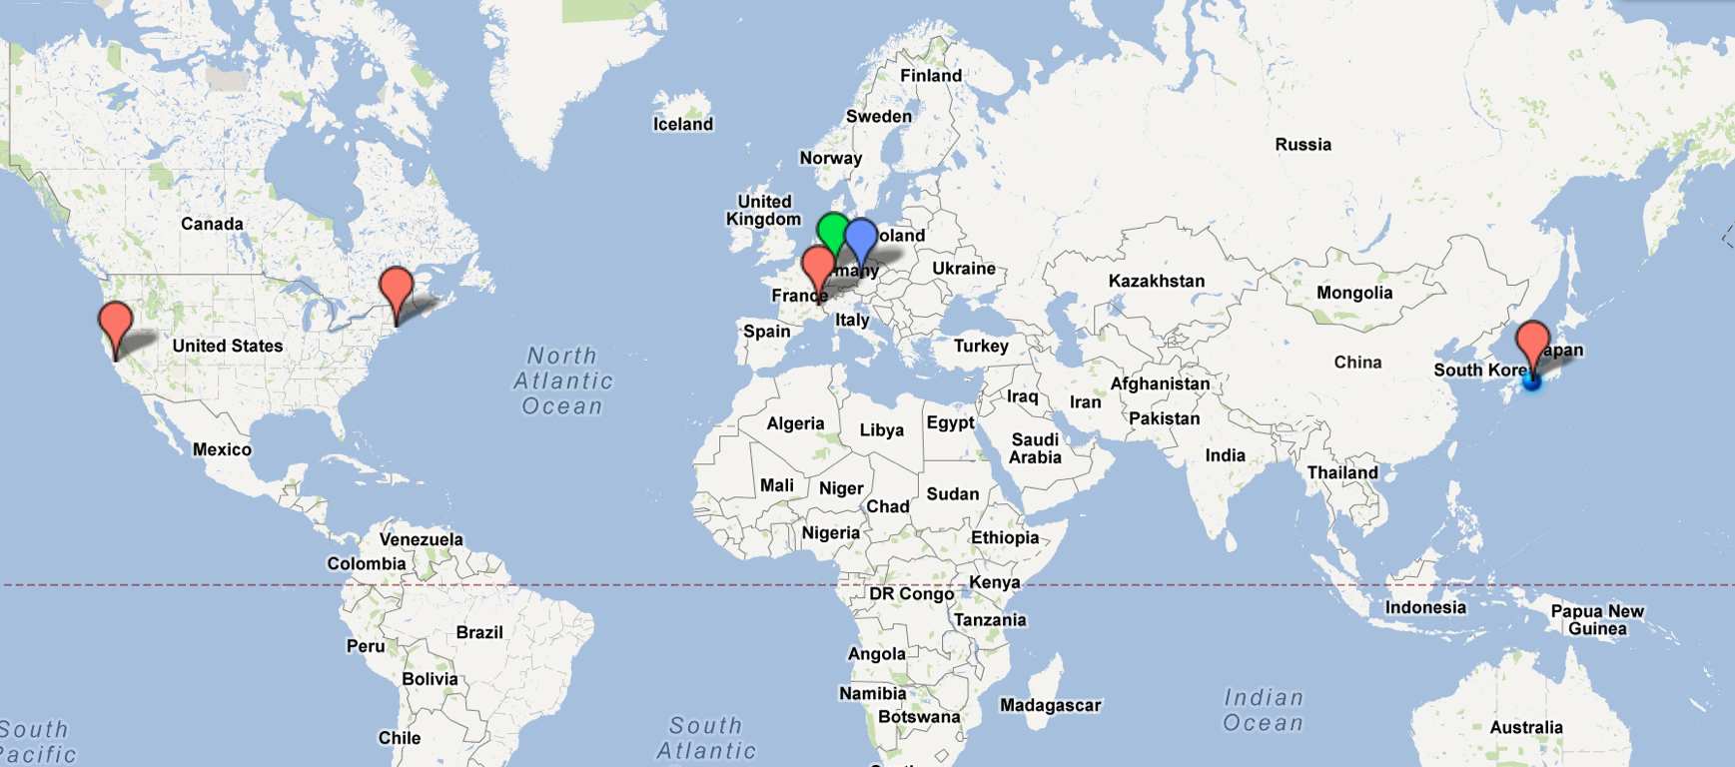
Kai Kunze
from a small village near Heidelberg, Germany
phD. from Uni Passau
3 months visiting researcher at the Media Lab (MIT, Cambridge)
internship at Palo Alto Research Center (formerly Xerox Parc)
MSc. thesis at Sunlabs, Grenoble, France
research topics:
pervasive and ubiquitous computing
specialization in
wearable computing
activity recognition
planed focus:
human computer interaction
participatory sensing
skill set:
applied pattern recognition / machine learning
scientific methodology / experimental setups
networking and distributed systems
some applied signal processing (filtering)

Slide 3
Complete overview
Introduction to Hidden Markov Modelle (HMM)
Application to actvitity recognition
Estimation of model parameters on data

Slide 4
Overview: Introduction to HMMs
Event sequences
Why?
Scope and problems
Example: complex sequences of coin tosses
Naive calculation
Better representation
Better algorithms
Hidden Markov Models
Formal description

Slide 5
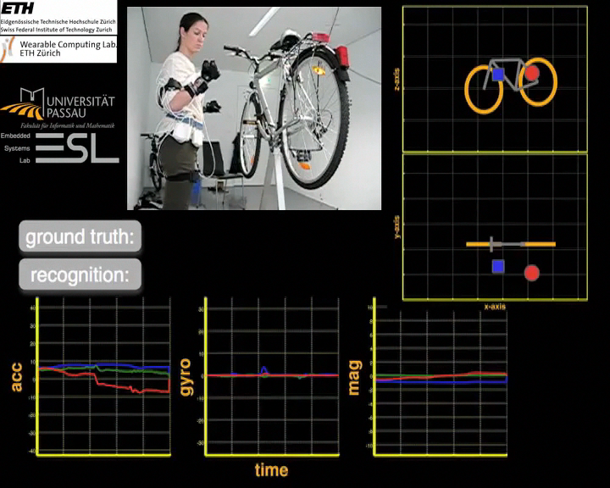
activity recognition

Slide 6
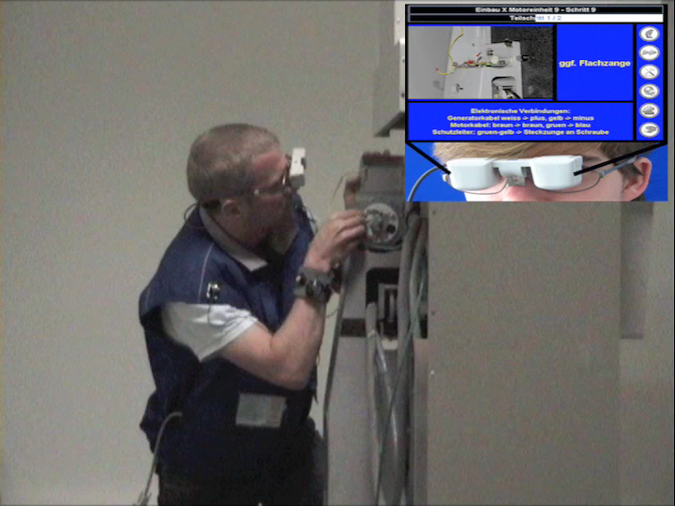
Example: Maintenance Scenario

Slide 7
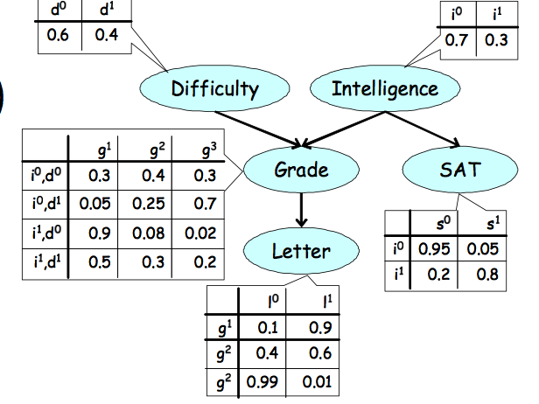
Review: Bayesian Networks
How to represent a sequence of actions using a graphical model?

Slide 8


Other applications of HMMs
Speech recognition and synthesis
Machine translation
Alignment of bio sequences

Slide 9
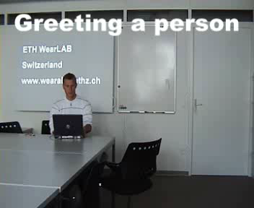
Greeting somebody
Activity
Person sits
Stands up
Shakes hands
Sits down again
Notes:
Wie kann man damit die aktivität erkennen. Dazu möchte ich ihnen einen typischen ausschnitt aus einem meeting zeigen

Slide 10
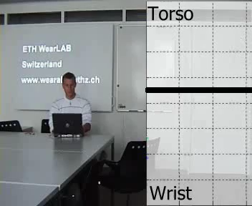
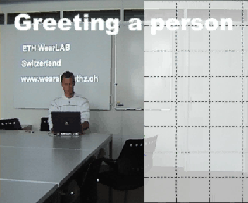
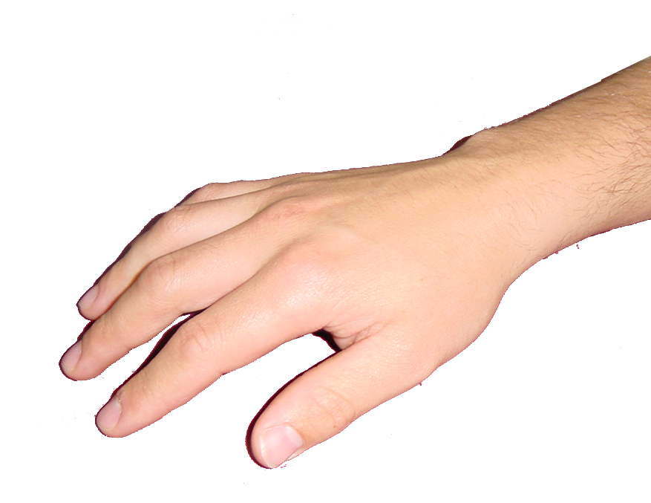
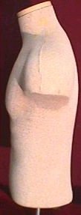
Greeting somebody
+1g
-1g
+2g
/+2g
0g
/0g
-2g
/-2g

Slide 11
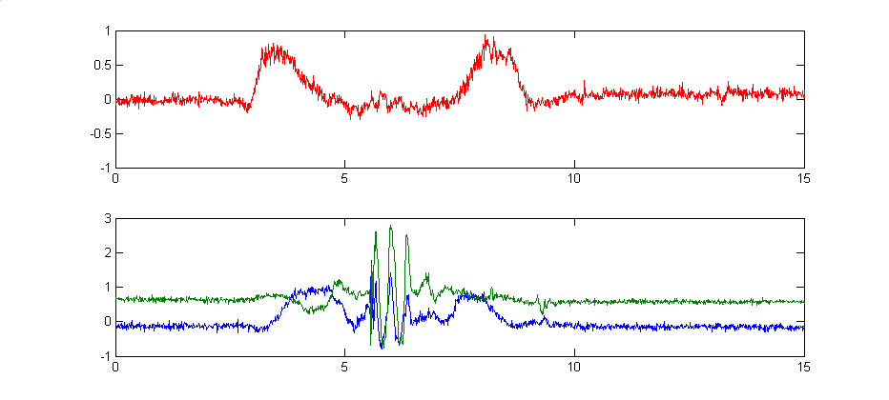

Analysis of the sensor signals
torso
sit
Stand up
stand
Sit down
sit
Beschleunigung [g]
wrist
Shake hands
movement
movement
On desk
On desk
Zeit [s]
Kombination von Einzelinformationen charakteristisch für Aktivität

Slide 12
summary: sequences and activity
We can describe an activity as a sequence of states
E.g. greeting somebody as a sequence of movements
In every state we have specific measurements or observations
Task:
Infer the activity given a sequence of measurements

Slide 13
Problems
Very variable processes
The length of individual phases might vary a lot
Some phases might be dropped
Very complex PDFs
Single „time steps“ are not independent
Often no closed analytical form
Often not derivable from physical properties

Slide 14
Tracking vs. Sequence recognition
Tracking:
one, time dependent, probabilistic process
Task: estimate one sequence from measurements and the most likely current state
Methods: Filtering (Kalman, Particle)
recognition of sequences (time series analysis):
mutlipe, time dependent, probabilistic processes
Task: decide given a series of measurements from which process they originated
Methods: ??

Slide 15
Recognition of Sequences
Process P‘
Process P‘‘
t
z‘₁
z‘‘₁
z‘₂
z‘‘₂
z‘₃
z‘‘₃
…
…
z‘_{N}
z‘‘_{N}

Slide 16
Recognition of Sequences
Process P‘
Process P‘‘
t
?????
z*₁
z*₂
z*₃
…
z*_{N}

Slide 17
Example: Coin-Experiment
Coin 0
Real coin
Coin 1
Fake coin
Assuming we observe the following sequence:
Heads, Tails, Tails (H,T,T)
Which coin was most likely used?

Slide 18
Procedure for Recognizing Sequences
Process Modelling
A function or algorithm that can produce the measurement with the same probability
Calculation of the probability
Formal description of the PDF
Efficient representation
Classification with a suitable classifier

Slide 19
Coin-Experiment: Model
Coin 0
Real coin
P(Heads)=P(Tails)=0.5
Coin 1
Fake coin
P(Heads)=0.4, P(Tails)=0.6

Slide 20
Coin-Experiment: Probabilities
State space X, Coin 0 or 1:
X={x₀,x₁}
Measurements Z, Sequence of 3 throws:
Z={H,T}³
A priori probabilities:
P(H,T,T¦ x₀)=P(H¦ x₀)P(T¦ x₀)P(T¦ x₀)=0.125
P(H,T,T¦ x₁)=P(H¦ x₁)P(T¦ x₁)P(T¦ x₁)=0.144

Slide 21
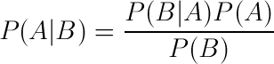
Coin-Experiment: Classification
MAP using Bayes
Event probabilities
P(x₀)=P(x₁)=0.5
Normalization
P(H,T,T)= (P(H,T,T¦ x₀)+ P(H,T,T¦ x₁))/2=0.132
A posteriori probabilities:
P(x₀¦H,T,T)=(0.125*0.5)/0.132= 0.465
P(x₁¦H,T,T)=(0.144*0.5)/0.132= 0.535
Maximum a posteriori (MAP) estimation:
P(x₁¦H,T,T)>P(x₀¦H,T,T) -> x₁ (fake coin)

Slide 22
Overview
Event sequences
Why?
Scope and problems
Example: complex seqeunces of coin tosses
Naive caluclation
Better representation
Better algorithms
Hidden Markov Models
Formal description

Slide 23
Coin experiment with switching coins
Coin 0
P(Head)=P(Tail)=0.5
Coin 1
P(Kopf)=0.4, P(Zahl)=0.6
Probability for switching coins between throws
P(x₀ -> x₁)=0.5 => P(x₀ -> x₀)=0.5
P(x₁ ->x₀)=0.5 => P(x₁ -> x₁)=0.5
initial probabilities P_{I}(x₀) =P_{I} (x₁)=0.5
We still observe z=(K,Z,Z) :
What is the most likely sequence of coins?
What is the probability that z=(K,Z,Z) was created by the expriment described above?

Slide 24
Coin experiment and context recognition
Probability that the sequence z=(K,Z,Z)was created by the experiment?
Every activity could be defined by „coin pairs“
Most probable sequence(s) of coins?
Every activity could belong to a specific sequence

Slide 25
Calculation of the probabilities
State space X, all possible sequences of coins
X={x₀ x₀ x₀, x₀ x₀ x₁,........, x₁ x₁ x₁}
Measurements Z, Sequence of three throws
Z={K,Z}³
probabilities
P(K,Z,Z, x₀ x₀ x₀ )=P(x₀ x₀ x₀ )*P(K,Z,Z| x₀ x₀ x₀ )
=P(x₀) P(x₀) P(x₀)P(K¦ x₀ ) P(Z¦ x₀ ) P(Z¦ x₀ )
=(0.5*0.5*0.5)*(0.5*0.5*0.5)= 0.015625
P(K,Z,Z, x₀ x₀ x₁ )=P(x₀ x₀ x₁ )*P(K,Z,Z| x₀ x₀ x₁ )
P(x₀) P(x₀) P(x₁) P(K¦ x₀ ) P(Z¦ x₀ )P(Z¦ x₁ )
=(0.5*0.5*0.5)*(0.5*0.6*0.5)= 0.01875

Slide 26
Probability Table
Sequence | P(Sequence) | P(HTT¦Sequence) | total
x_{0,} x_{0,} x₀ | 0.5*0.5*0.5=0.125 | 0.5*0.5*0.5=0.125 | 0.125*0.125=0.015625
x_{0,} x_{0,} x₁ | 0.5*0.5*0.5=0.125 | 0.5*0.5*0.6=0.150 | 0.125*0.150=0.01875
x_{0,} x_{1,} x₀ | 0.5*0.5*0.5=0.125 | 0.5*0.6*0.5=0.150 | 0.125*0.150=0.01875
x_{0,} x_{1,} x₁ | 0.5*0.5*0.5=0.125 | 0.5*0.6*0.6=0.180 | 0.125*.180=0.0225
x_{1,} x_{0,} x₀ | 0.5*0.5*0.5=0.125 | 0.4*0.5*0.5=0.100 | 0.125*0.100=0.0125
x_{1,} x_{0,} x₁ | 0.5*0.5*0.5=0.125 | 0.4*0.5*0.6=0.120 | 0.125*0.120=0.015
x_{1,} x_{1,} x₀ | 0.5*0.5*0.5=0.125 | 0.4*0.6*0.5=0.120 | 0.125*0.120=0.015
x_{1,} x_{1,} x₁ | 0.5*0.5*0.5=0.125 | 0.4*0.6*0.6=0.144 | 0.125*0.144=0.018
P(HTT)=0.136125

Slide 27
Problems
Clarity
Number of states N
Number of measurements/observations T
Exponentially complex:
~T*N^{T}

Slide 28
Overview
Event sequences
Why?
Scope and problems
Example: complex sequences of coin tosses
Naive calculation
Better representation
Better algorithms
Hidden Markov Models
Formal description

Slide 29
Idea
time discrete processes are easy to describe formally using finite state machine
Use a probabilistic (Bayesian) version of a finite state machine for process description

Slide 30
States for the coin sequence
Heads
Tails
Heads
Tails
Coin 0
Coin 1
In every discrete time step:
Observation(Heads or Tails)
Transition (switch coin or it stays the same)

Slide 31
States for the coin sequence
Heads
Tails
Heads
Tails
Coin 0
Coin 1
x₀, H

Slide 32
States for the coin sequence
Heads
Tails
Heads
Tails
Coin 0
Coin 1
x₁, T

Slide 33
States for the coin sequence
Heads
Tails
Heads
Tails
Coin 0
Coin 1
x₁, T

Slide 34
Trellis-Graph for discrete time series
time slices
state
Observation
(output)
H

Slide 35
Trellis of the coin sequence
x₀ x₁ x₁, HTT
H
T
T

Slide 36
Trellis of the coin sequence
x₀ x₁ x₁, HTT
H
T
T

Slide 37
Naive Computation of the Trellis
Total probability
Sum up all the traces of the Trellis
Most likely trace
The maximum of all traces of the Trellis

Slide 38
Overview
Event sequences
Why?
Scope and problems
Example: complex seqeunces of coin tosses
Naive caluclation
Better representation
Better algorithms
Hidden Markov Models
Formal description

Slide 39
Probability for the model ('belief state’)
Idea: a lot of probabilities are calculated several times during the naive calculation
Forward Algorithm

Slide 40
‚Forward‘ calculation
H
T
T

Slide 41
‚Forward‘ calculation
H
T
T

Slide 42
‚Forward‘ calculation
H
T
T

Slide 43
‚Forward‘ Berechnung
H
T
T

Slide 44
‚Forward‘ Berechnung
H
T
T

Slide 45
Total probability
H
T
T

Slide 46
Probability Table
Sequence | P(Sequence) | P(HTT¦Sequence) | total
x_{0,} x_{0,} x₀ | 0.5*0.5*0.5=0.125 | 0.5*0.5*0.5=0.125 | 0.125*0.125=0.015625
x_{0,} x_{0,} x₁ | 0.5*0.5*0.5=0.125 | 0.5*0.5*0.6=0.150 | 0.125*0.150=0.01875
x_{0,} x_{1,} x₀ | 0.5*0.5*0.5=0.125 | 0.5*0.6*0.5=0.150 | 0.125*0.150=0.01875
x_{0,} x_{1,} x₁ | 0.5*0.5*0.5=0.125 | 0.5*0.6*0.6=0.180 | 0.125*.180=0.0225
x_{1,} x_{0,} x₀ | 0.5*0.5*0.5=0.125 | 0.4*0.5*0.5=0.100 | 0.125*0.100=0.0125
x_{1,} x_{0,} x₁ | 0.5*0.5*0.5=0.125 | 0.4*0.5*0.6=0.120 | 0.125*0.120=0.015
x_{1,} x_{1,} x₀ | 0.5*0.5*0.5=0.125 | 0.4*0.6*0.5=0.120 | 0.125*0.120=0.015
x_{1,} x_{1,} x₁ | 0.5*0.5*0.5=0.125 | 0.4*0.6*0.6=0.144 | 0.125*0.144=0.018
P(HTT)=0.136125

Slide 47
‚Forward‘ calculation: complexity
N additions
1 multiplication
N additions
1 mutliplication
1 multiplication
O(N)
O(N*N)
O(N*N)
H
T
T

Slide 48
‚Forward‘ calculation: complexity
T times -> complexity O(T* N²)
O(N)
O(N*N)
O(N*N)
H
T
T

Slide 49
most likely sequence
Idea: utilize already calculated values similuar to the Forward-Algorithm
Calculate the maximum instead of the sums!
Viterbi Algorithm

Slide 50
viterbi calculation
H
T
T

Slide 51
Viterbi calculation
H
T
T

Slide 52
Viterbi calculation
H
T
T

Slide 53
Viterbi calculation

Slide 54
Viterbi calculation
H
T
T

Slide 55
Probability Table
Sequenz | P(Sequenz) | P(KZZ¦Sequenz) | gesamt
x_{0,} x_{0,} x₀ | 0.5*0.5*0.5=0.125 | 0.5*0.5*0.5=0.125 | 0.125*0.125=0.015625
x_{0,} x_{0,} x₁ | 0.5*0.5*0.5=0.125 | 0.5*0.5*0.6=0.150 | 0.125*0.150=0.01875
x_{0,} x_{1,} x₀ | 0.5*0.5*0.5=0.125 | 0.5*0.6*0.5=0.150 | 0.125*0.150=0.01875
x_{0,} x_{1,} x₁ | 0.5*0.5*0.5=0.125 | 0.5*0.6*0.6=0.180 | 0.125*.180=0.0225
x_{1,} x_{0,} x₀ | 0.5*0.5*0.5=0.125 | 0.4*0.5*0.5=0.100 | 0.125*0.100=0.0125
x_{1,} x_{0,} x₁ | 0.5*0.5*0.5=0.125 | 0.4*0.5*0.6=0.120 | 0.125*0.120=0.015
x_{1,} x_{1,} x₀ | 0.5*0.5*0.5=0.125 | 0.4*0.6*0.5=0.120 | 0.125*0.120=0.015
x_{1,} x_{1,} x₁ | 0.5*0.5*0.5=0.125 | 0.4*0.6*0.6=0.144 | 0.125*0.144=0.018
P(KZZ)=0.136125

Slide 56
Summary
Graphical modelling can make it
easy to describe discrete sequences and can make the calcualtion of probabilities more efficient

Slide 57
Overview
Event sequences
Why?
Scope and problems
Example: complex seqeunces of coin tosses
Naive caluclation
Better representation
Better algorithms
Hidden Markov Models
Formal description

Slide 58
Hidden Markov Model (HMM)
Observations
Observation probabilities b_{jk}
Heads
Tails
Heads
Tails
Coin 0
states
Coin 1
Initial
probabilities
Transition probabilities a_{ij}

Slide 59
Rückblick: HMM Definition
N: Number of states
M: Number of possible observations
X: measurement states X={X_{1,} X_{2,.....,} X_{N}}={1,2,....N}
Z: Observation states Z ={Z_{1,} Z_{2,.....,} Z_{N}}={1,2,....N}
Transition matrix A
a_{ij}: Probability to change from state Z_{i} to Z_{j}
Output matrix B
b_{j}(k) probabiltiy of x_{j} being in state Z_{k}
Initial probabilities π:
Probabilities for the initial state of the system
HMM Model λ(Α,Β, π)

Slide 60
Hidden Markov Model (HMM)
t=1

Slide 61
Coins as HMM
N=2, M=2, T=3
X={coin 0, coin 1}={x₀,x₁}
Z={H, T}

Slide 62
HMM: Bemerkungen
‚Hidden‘ means that the state is not observable
Only the observations are visible
We deal with first order HMMs
State at time i depends only on the state i-1 (Markov assumption)
A lot of HMMs have symetires
The observations don‘t need to be discrete

Slide 63

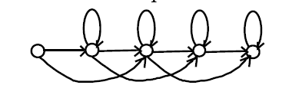
Special cases of HMMs
ergodic
sequential
Especially important for recongizing sequences\
Example: Speech recognition

Slide 64
HMMs with continous observations
If the observations are continous (e.g. accelerometer signals) we swap the Observation matrix with a distribution
Easy case: gauss distribution
More komplex processes: ‚mixture of Gaussians‘
General case: arbitrary distributions
Description and calculation problematic!!

Slide 65
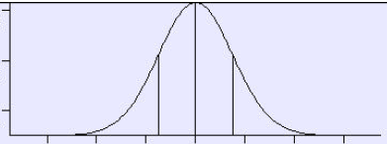
Example: HMM with Gauss distribution
200
190
Driver 1
Driver 2
Observation of the speed of a race car in a bend
2 drivers change every 20 laps
Driver 0 takes the bend with an average of 200 km/h
Driver 1 takes the bend with an average of 190 km/h

Slide 66
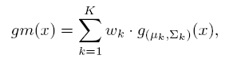
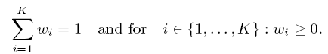
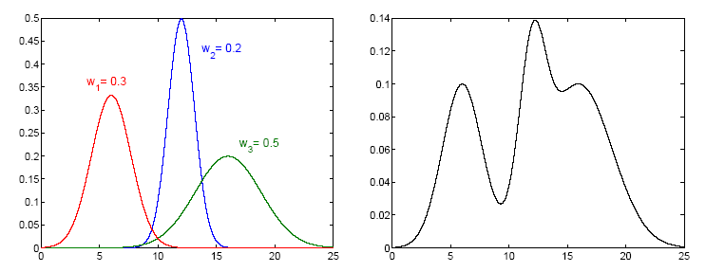
HMM using ‚Mixture of Gaussians‘ distributions
The PDF of the observations is expressed as the weighted sum of gaussians
Complex distributions
Simple description and calculation

Slide 67
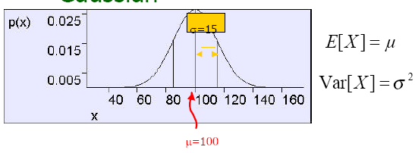
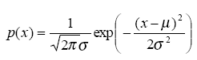
Description of HMMs with Gauss distribtutions
Gaussian distribution given by
Matrix B can be replaced by two matrices: durch 2 Matrizen:
B 1 for the means
B 2 for the variances
If ‚Mixture of Gaussians‘ are used
The number of matrices increases depending on the number of mixtures
Additional matrix for the weights

Slide 68
Trellis & Forward Algorithmus
P(z_{1,} z_{2,.....,} z_{T})
: Probability fo the observations at time t and being in state i

Slide 69
‚Forward‘ algorithm
: Probability fo the observations at time t and being in state i

Slide 70
Viterbi Algorithm
Initialization
At time t 0:
For every state calculate how likely it is to start in that state
Recursive calculation
for each time t:
Determine for each state from which state t-1 it resulted most likely

Slide 71
Viterbi Algorithm
Finalize
At time T:
Determine the most likely state x(T)
Backtrace
For each time t
Put in the sequence x(t-1) th state, from which x(t) most likely resulted (already calculated in 2.)

Slide 72
Viterbi Algorithm: Parameters
Cumulative probability of the most likely sequence including state i at time t
The previous state, from which state i at time t most likely resulted.

Slide 73
Viterbi calculation

Slide 74
Viterbi Algorithmus
Initialization
Recursive calculation

Slide 75
Viterbi Algorithm
finalizing
Backtrace of the optimal sequence

Slide 76
Summary
Time series analysis
problems
Tracking vs. Sequences of states
HMM as a probabilistic finite state machine
Graphical representation
parameterization
Ergodic und sequential HMMs
Differnt probabilistic models (gaussian etc.)
Trellis
Forward-Algorithm
Viterbi-Algorithm

